Slide 1
Site Access Checkpoint
Created by: Nisha Verma, Jay Jatin, Cameron Simon

Slide 2
Table of Contents
Introduction and Terminology
Background Info
Needs of the Client
Design Decisions
Implementation
Security and Maintenance
Testing
Summary

Slide 3
Introduction
Time/Attendance system for the contractors working at construction jobsites.
Client - CSM Group

Slide 4
Terminology
Client - CSM Group
Admin - CSM Group’s Employee (Project Manager)
Contractors - People working at CSM Group’s Jobsite
PIN - 5 digit Contractor ID

Slide 5
Client’s Background
CSM Group - Construction Services Management Company
43 Active jobsites in 26 states
Managing projects in Healthcare, Food & Beverage, Education, Advanced Technologies, Commercial, and Industrial Manufacturing.

Slide 6
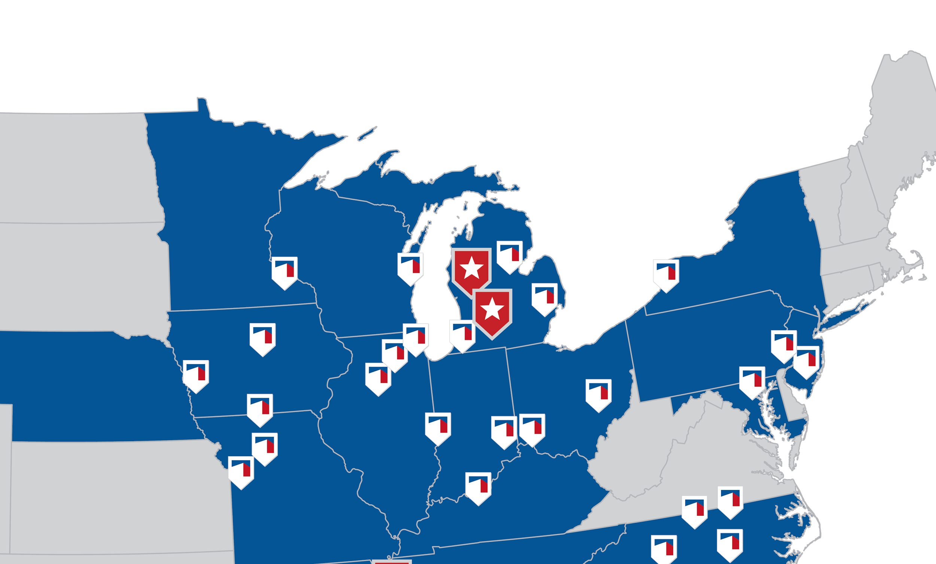
Application Testing Sites

Slide 7
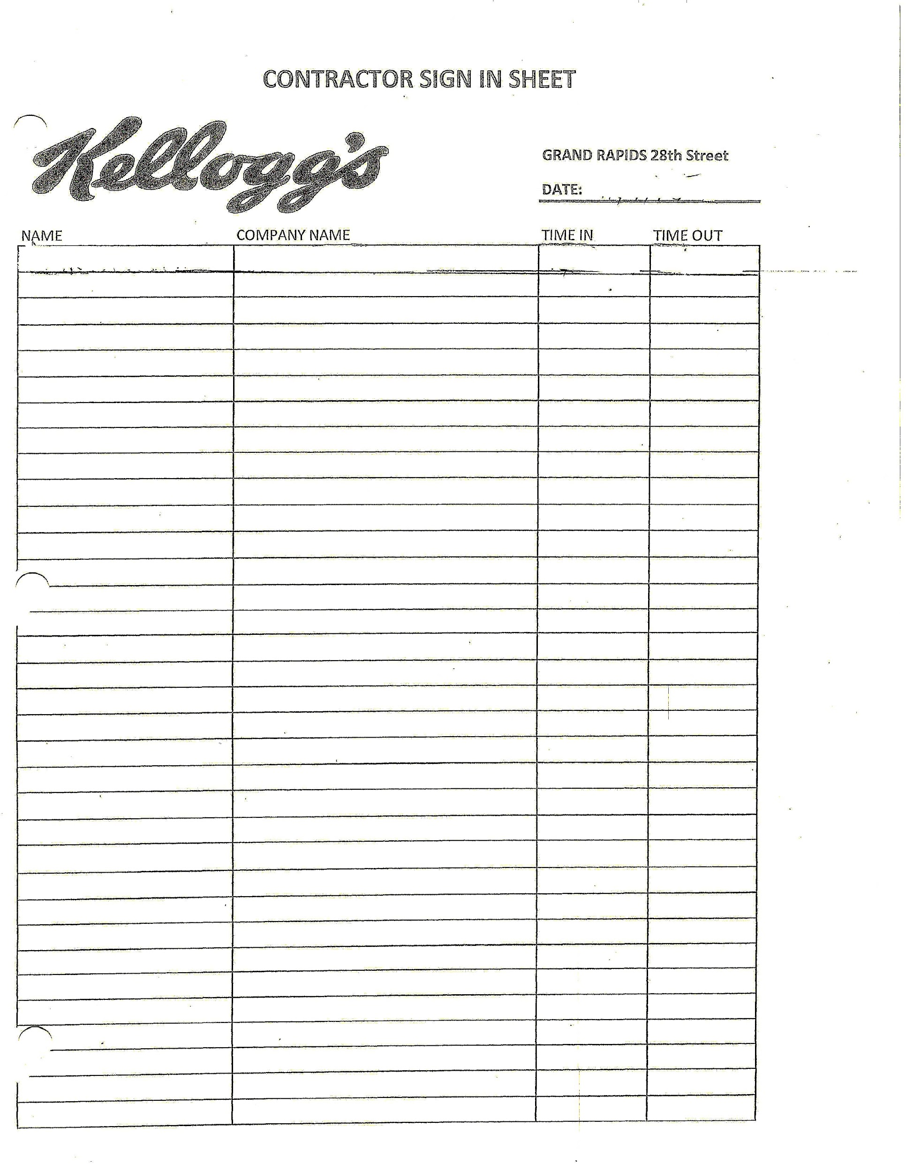
Current System
Fields
Name
Company name
Time In
Time Out

Slide 8
Needs of the Client
Simple and Easy to use application to replace the Paper-Pen system for contractors’ daily sign in sheet.
Cross check contractor’s safety training status with Time/Attendance system.
Daily and Weekly reports for job site owner(s) and client.

Slide 9
Design Decisions

Slide 10
Before Meeting Client
PHP with Laravel Framework
Ruby on Rails

Slide 11
After Meeting Client
Initially
Java, AngularJS, and Google App Engine
Final Choice
AngularJS and Firebase.

Slide 12
Overview of Final Design Decision
Backend:
Firebase - a backend service that provides data storage, file storage, authentication, and static website hosting for the app.
Frontend:
AngularJS – Model View Controller (MVC) framework.
AngularFire - officially supported AngularJS binding for Firebase.
Bootstrap - framework for designing responsive web content.

Slide 13
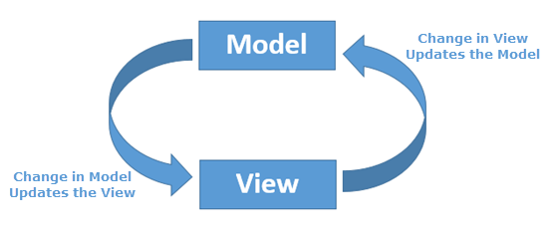
Why AngularJS ?
Two way data binding
Testing
Comprehensive
Scalable

Slide 14

Why Firebase ?
Easy Integration with AngularJS using AngularFire.
Real Time Database
Authentication
Data Hosting

Slide 15
Other Tools
HTML5 - Frontend
CSS - Frontend
Node.js - Runtime Environment
Brackets - Text Editor
Github - Collaboration Environment

Slide 16
Application Structure

Slide 17
Implementation

Slide 18
Key Features
Login and Logout ability for both Contractors and Admin
Dashboard for Admin
Safety Training page
Firebase for Security, Data Storage, and web hosting.

Slide 19
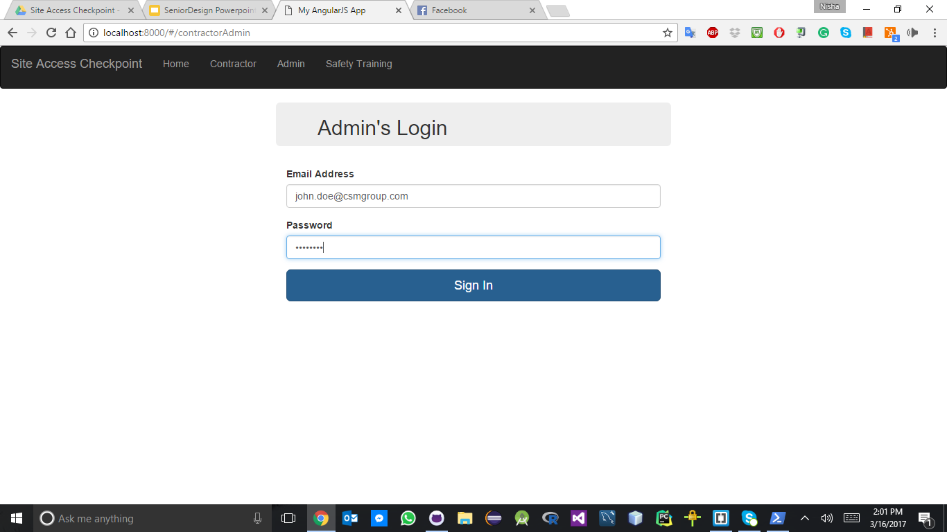
1. Admin’s Login
Ability to login with custom email.
Authentication security provided by Firebase.

Slide 20
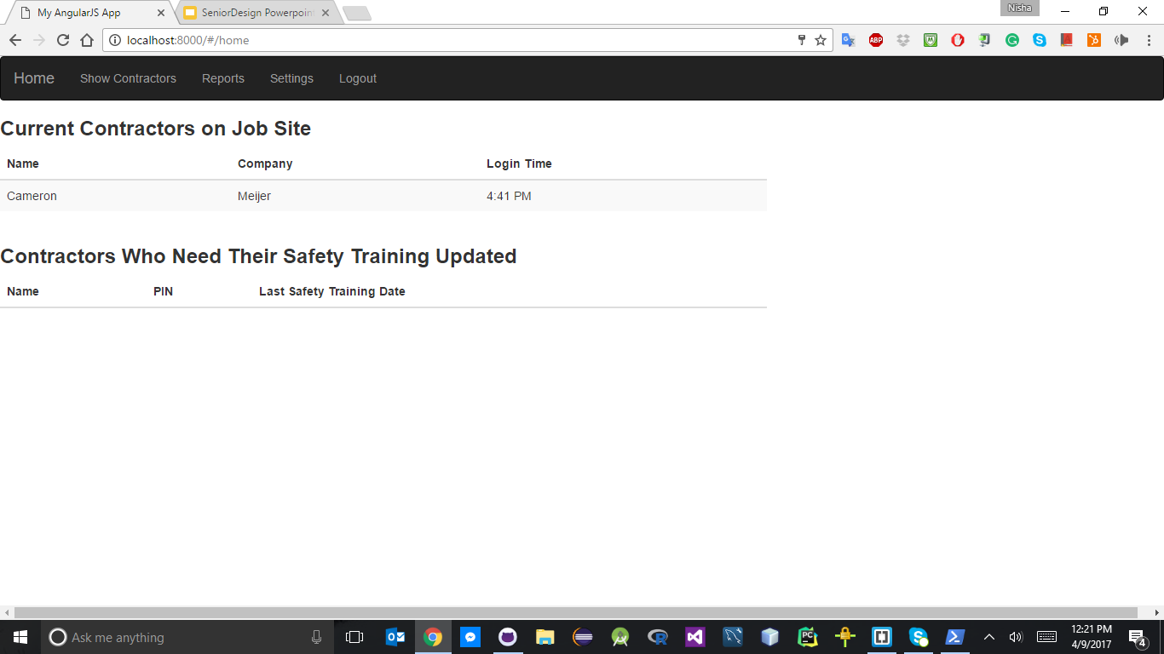
a) Admin’s Homepage
Show all contractors currently on site with login time.
Show all the contractors who needs their safety training updated.

Slide 21
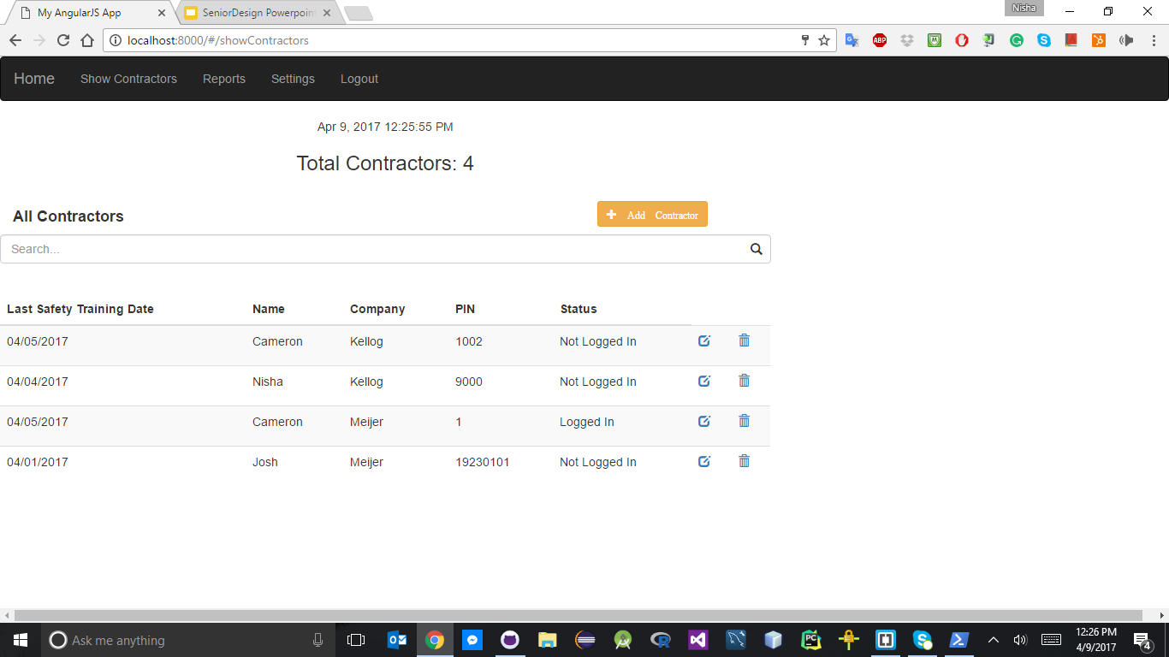
b) Show Contractors
Ability to see all the contractors and their profile information.
Edit any contractor.
Delete any contractor.
Add a new contractor.
Search a contractor.

Slide 22
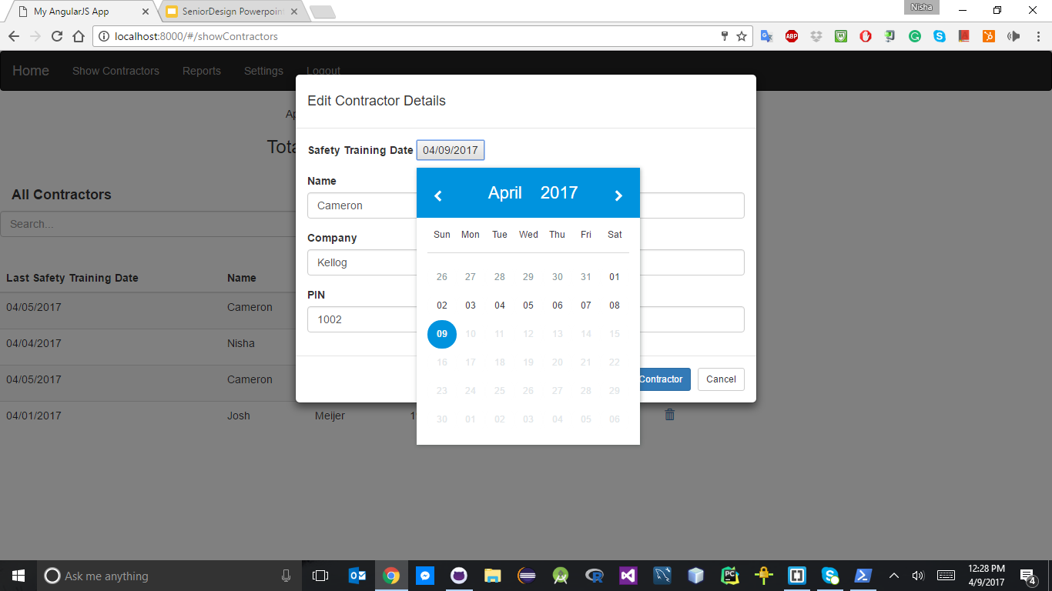
a) Show Contractors (continued)
Updating information for a contractor.

Slide 23
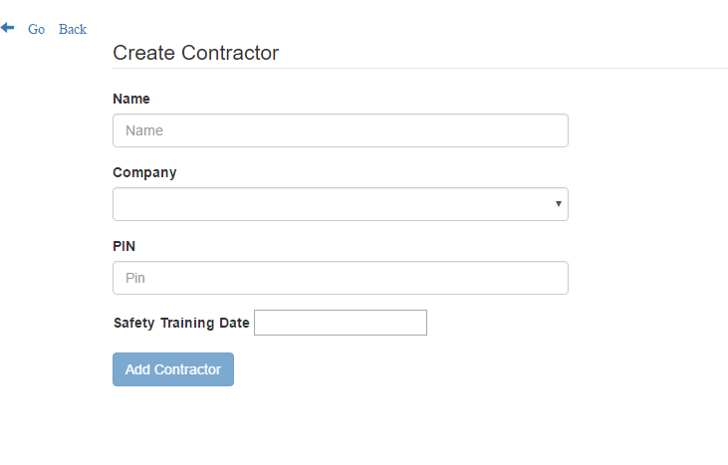
a) Show Contractors (continued)
Adding new contractor.

Slide 24
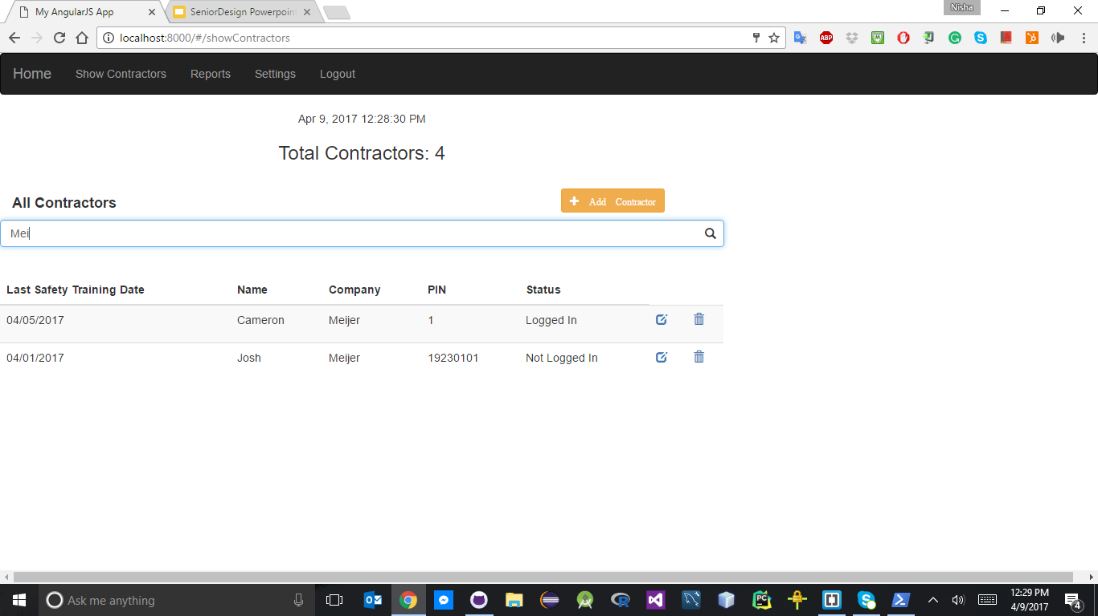
a) Show Contractors (continued)
Search contractors by their name, company name, or a pin.

Slide 25
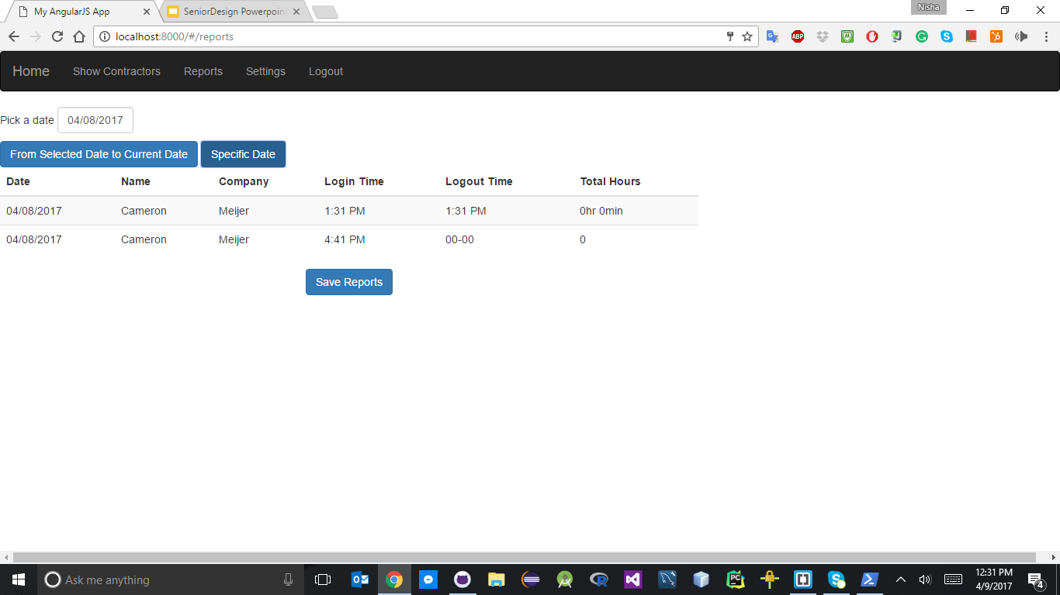
b) Reports
Ability to see contractors’ login information.
Ability to save these reports in csv format.

Slide 26
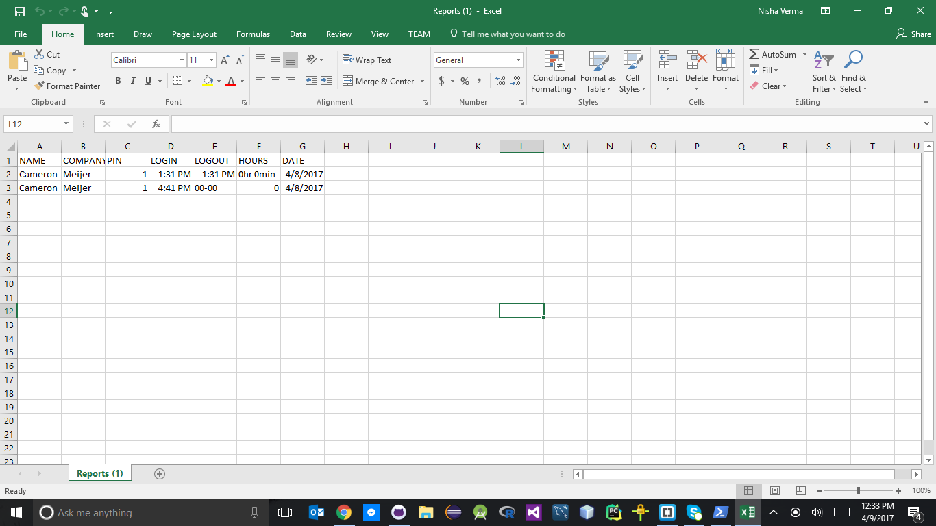
b) Reports (continued)
Display reports in file.

Slide 27
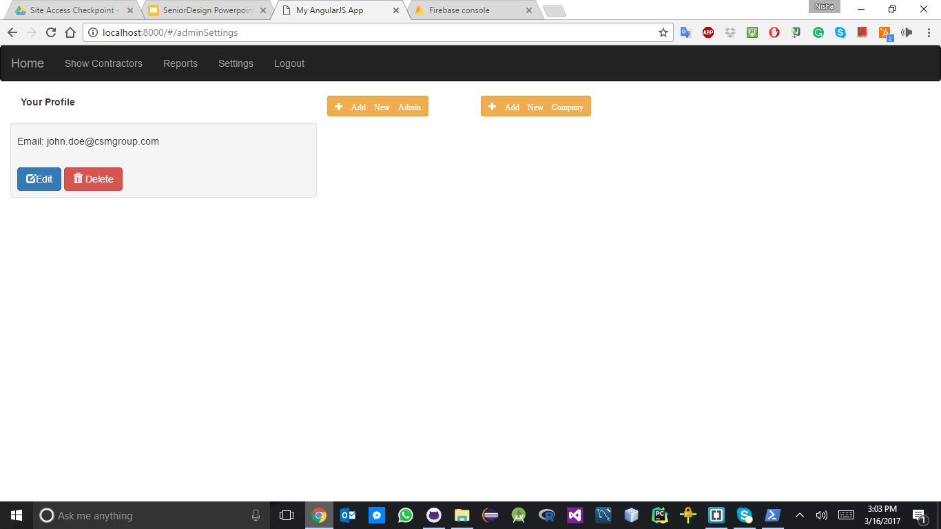
c) Settings
Ability to edit or delete Admin’s profile.
Add new admin to the system.
Add new company.

Slide 28
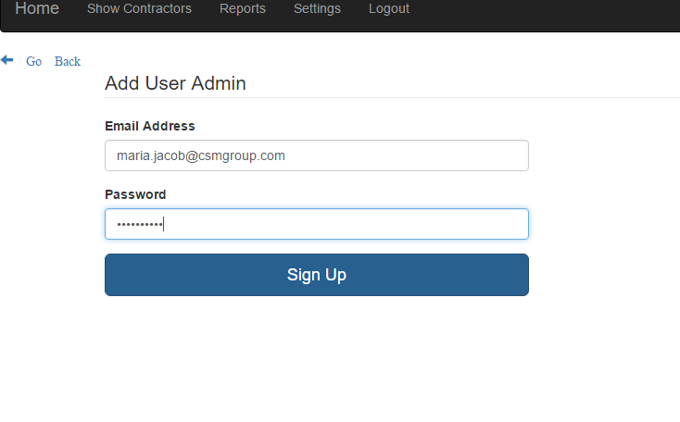
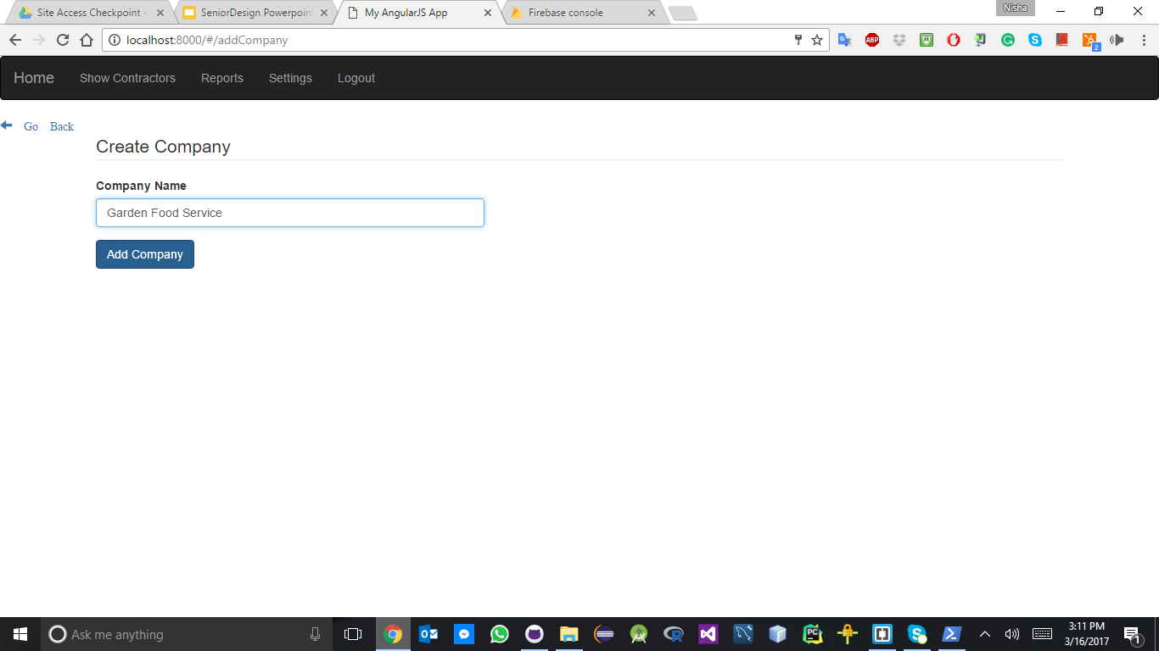
c) Settings (continued)
Add Admin
Add Company

Slide 29
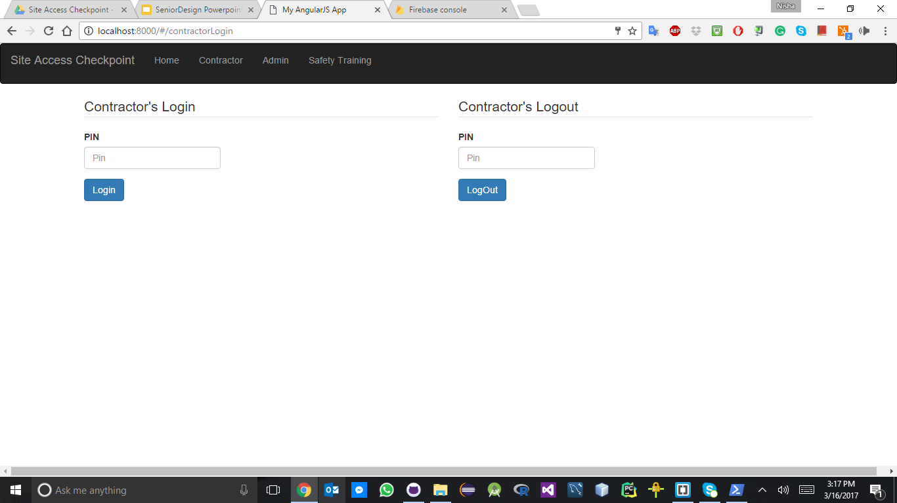
2. Contractors
Ability to login and logout with their unique pin number.

Slide 30
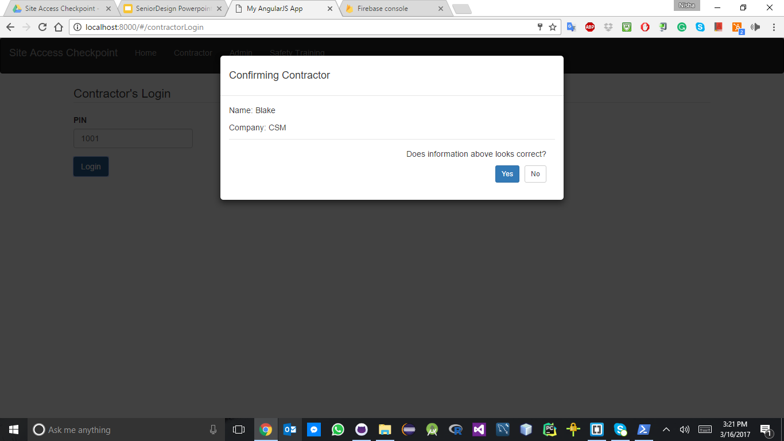
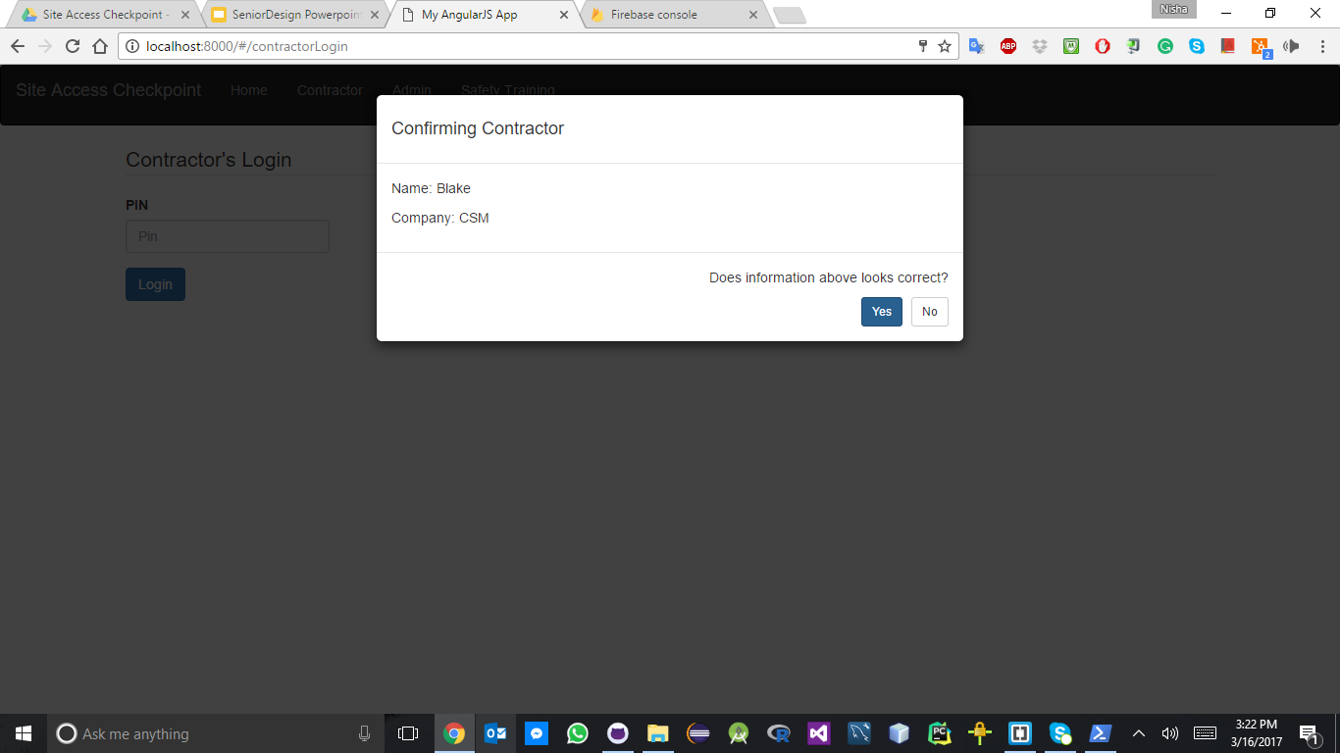
Contractors (continued)
Login
Logout

Slide 31
Security and Maintenance

Slide 32
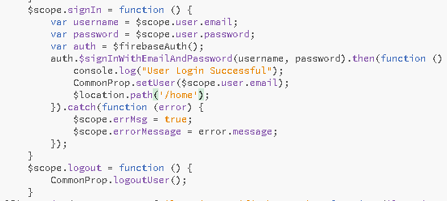
Security For Firebase
Security for database by Firebase
Easy authentication

Slide 33
Security For Firebase (Continued)
Login and logout for Contractors easily done through unique PINs
Unique PINs enforced by system.
Provides a SSL certificate
Helps with encryption of the data.
Followed guidelines from:
https://firebase.google.com/docs/database/security/

Slide 34
Security for AngularJS
HTML Injection Protection
JSON Hijacking Protection
CSRF or Cross Site Request Forgery protection.
Following guidelines for:
https://docs.angularjs.org/guide/security

Slide 35
Security Considerations Through Firebase
Formatting what data should look like coming into the database can be checked.
Permissions can be set on who can read and write data.

Slide 36
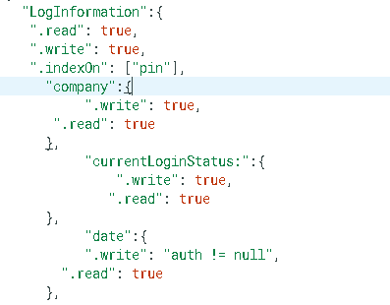
Example of Firebase Security Rules

Slide 37
Firebase Console Authentication

Slide 38
Maintenance
Upkeep and maintenance will be done by CSM
Code is easy to find and locate within project structure
Code is located on GitHub for easy collaboration.
Maintenance document was created to help with this.

Slide 39
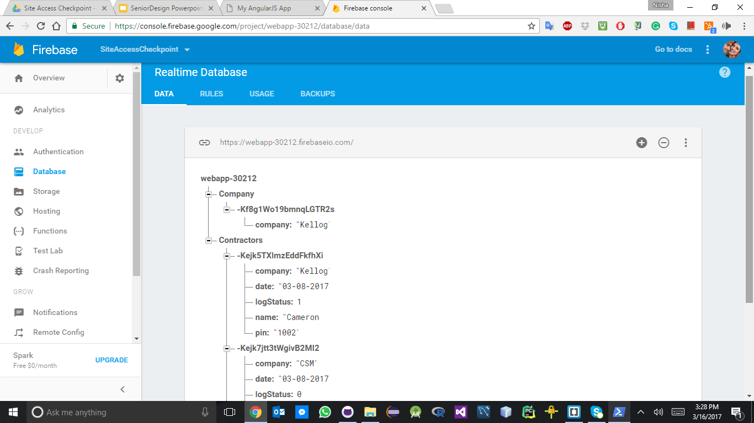
Firebase Console Database Info

Slide 40
Testing

Slide 41
Testing
Karma
Spawns a test server that loads application and runs tests.
Jasmine
Keeps test well documented and structured
Allows for making asserts, or what the result of a process should be

Slide 42
Example of Good Test

Slide 43
Example of Bad Test

Slide 44
Summary
Goal: Create a replacement to the paper and pen method of signing in contractors on job sites
Our web application will be run locally using AngularJS and Firebase.
The Site Access Checkpoint Application will be tested at the Grand Rapids and Kalamazoo job sites.

Slide 45
Questions?

